Slide 1

Monday, October 22, 2012
TISK Problems
Add: $\frac{1}{5}+\frac{3}{4}$
Multiply: $\frac{3}{8}\left(\frac{1}{6}\right)$
Evaluate: $\frac{5}{9}\left(\frac{6}{20}\right)−\frac{1}{12}$
We will have 3 Mental Math Questions today.
Homework:
Theoretical Probability Practice worksheet
Notes:
Mental Math
Start with the fifth multiple of 8. Double it. Double it again. Divide by the square of 4. Write your answer.
Start with the sixth multiple of 7. Double it. Double it again. Add 3. Divide by the square of 3. Write your answer.
Start with the ninth multiple of 13. Double it. Double it again. Divide by the square of 2. Write your answer.

Slide 2
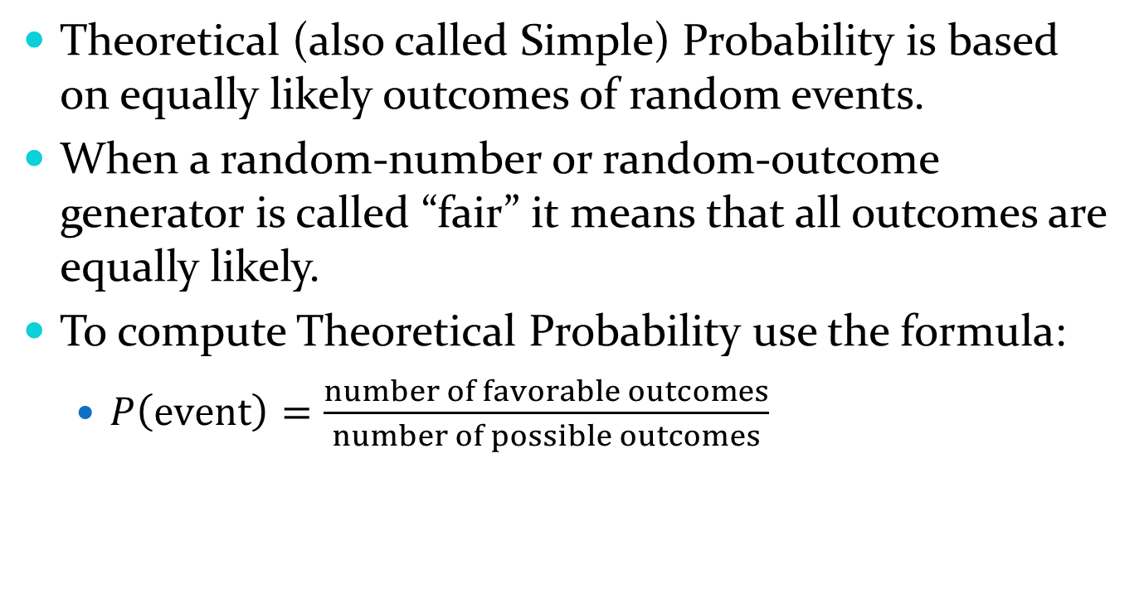
§9-3 Theoretical Probability
Theoretical (also called Simple) Probability is based on equally likely outcomes of random events.
When a random-number or random-outcome generator is called “fair” it means that all outcomes are equally likely.
To compute Theoretical Probability use the formula:
  $P\left(event\right)=\frac{number of favorable outcomes}{number of possible outcomes}$

Slide 3
§9-3 Theoretical Probability
Two or more events
  Disjoint or Mutually Exclusive
    If one event occurs the other CANNOT occur in the same trial.
    Examples:
      Event A: Roll a 3 on a 6-sided die. Event B: Roll a 4 on a 6-sided die.
      All your names are placed in a hat. Event A: Draw _________. Event B: Draw _____________.
    To find probability of Disjoint Events:
      P(A or B) = P(A) + P(B)
      P(A and B) = 0

Slide 4
§9-3 Theoretical Probability
Complementary Events.
If the first event is event A then its complementary event is “not A”.
For example:
  What is the probability that if I place all your names in a hat, I draw a girl’s name?
    P(girl’s name)
  The complementary event would be…
    P(boy’s name) OR P(not girl’s name)
The probability of complementary events is always equal to one.
P(A) + P(not A) = 1

Slide 5
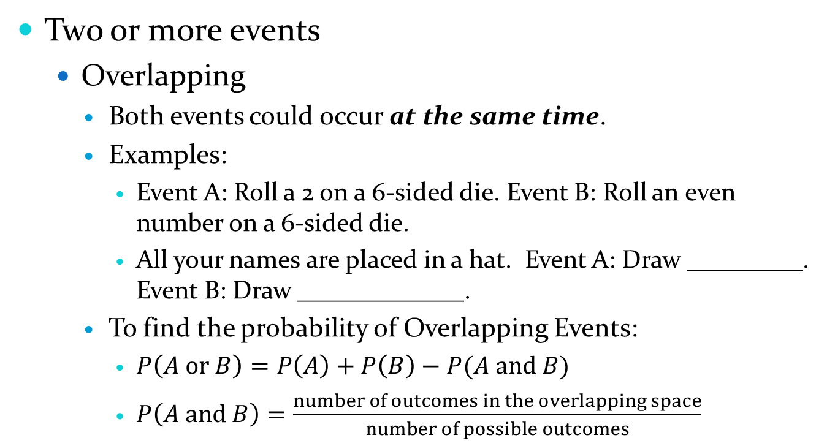
§9-3 Theoretical Probability
Two or more events
  Overlapping
    Both events could occur at the same time.
    Examples:
      Event A: Roll a 2 on a 6-sided die. Event B: Roll an even number on a 6-sided die.
      All your names are placed in a hat. Event A: Draw _________. Event B: Draw _____________.
    To find the probability of Overlapping Events:
      $P\left(A or B\right)=P\left(A\right)+P\left(B\right)−P(A and B)$
      $P\left(A and B\right)=\frac{number of outcomes in the overlapping space}{number of possible outcomes}$

Slide 6
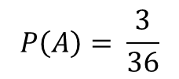
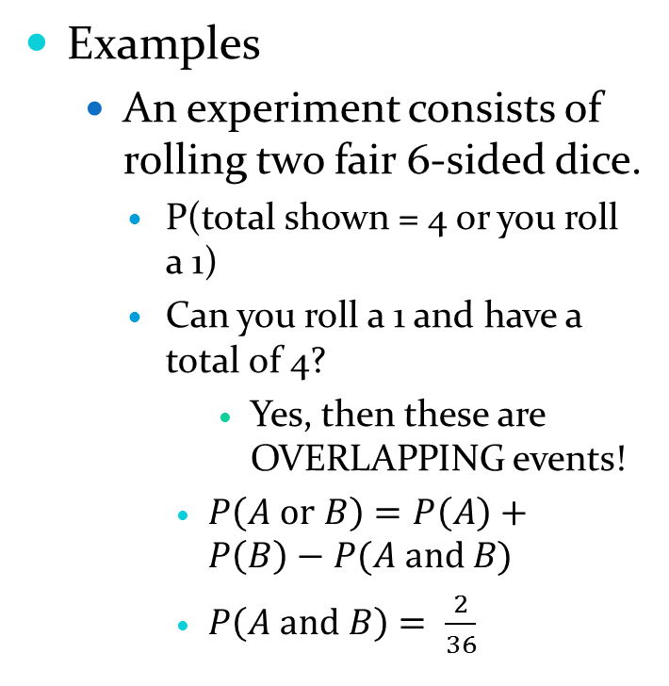
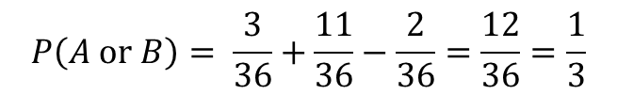
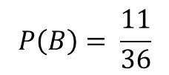
§9-3 Theoretical Probability
Examples
  An experiment consists of rolling two fair 6-sided dice.
    P(total shown = 4 or you roll a 1)
    Can you roll a 1 and have a total of 4?
        Yes, then these are OVERLAPPING events!
      $P\left(A or B\right)=P\left(A\right)+P\left(B\right)−P(A and B)$
      $P\left(A and B\right)= \frac{2}{36}$
D#1 D#2 | 1 | 2 | 3 | 4 | 5 | 6
1 | 2 | 3 | 4 | 5 | 6 | 7
2 | 3 | 4 | 5 | 6 | 7 | 8
3 | 4 | 5 | 6 | 7 | 8 | 9
4 | 5 | 6 | 7 | 8 | 9 | 10
5 | 6 | 7 | 8 | 9 | 10 | 11
6 | 7 | 8 | 9 | 10 | 11 | 12
$$P\left(A\right)= \frac{3}{36}$$
$$P\left(B\right)= \frac{11}{36}$$
$$P\left(A or B\right)= \frac{3}{36}+\frac{11}{36}−\frac{2}{36}=\frac{12}{36}=\frac{1}{3}$$

Slide 7
Homework
#1-4: No work necessary. Write your answers carefully to the right.
#5-17: Show your work. You may use an additional paper if necessary, or number your work as you do it across the page.
#15-17: Write your answer as a complete sentence.

